Slide 1
Final Year Project
Comparison between two machine learning algorithms on their ability to learn a top-down racing game
Cliona Hayden - C00225401

Slide 2
Introduction
The aim of this project is to compare two machine learning algorithms, backpropagation and reinforcement learning, on their efficiency to learn to play a top-down car racing game.
Comparison will be made between them based on their time taken to complete a lap of a track, performance and ease of implementation

Slide 3
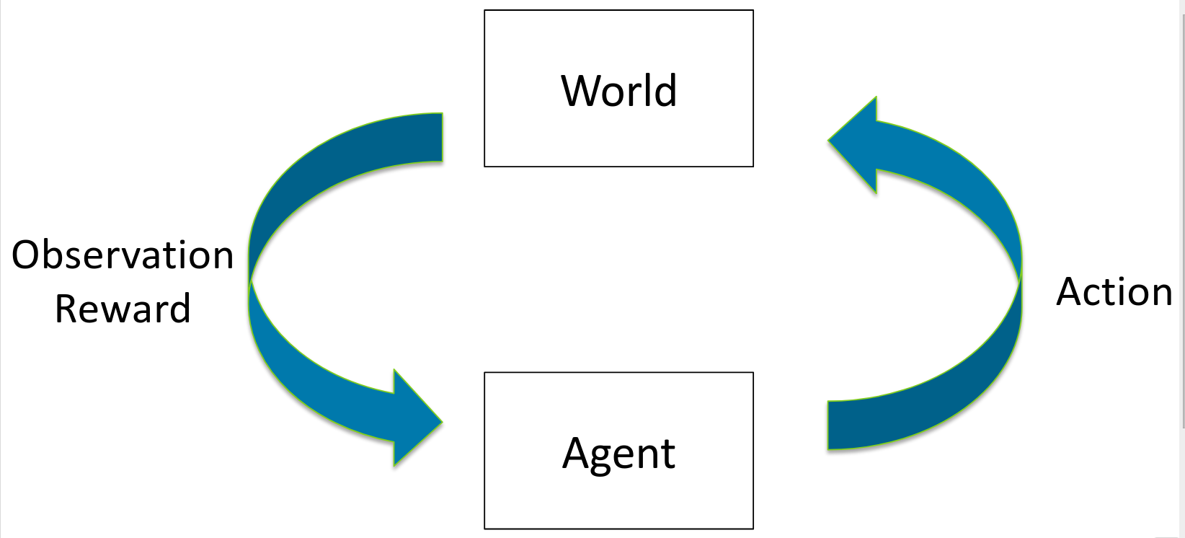
Reinforcement Learning
Works in a changing environment in an attempt to achieve a goal
Program is provided positive or negative feedback based on performance
Tries to maximise positive feedback and minimise negative feedback

Slide 4
Backpropagation
Calculates a gradient of a loss function with respect to the weights of the network using chain rule
Calculates one layer at a time
Iterates backwards to avoid unnecessary calculations

Slide 5
Technical Details
Base Game: C++ and SFML
Machine learning algorithms: Python and TensorFlow
Network trained on an identical model using python, then weights will be exported and loaded into the C++ model.

Slide 6
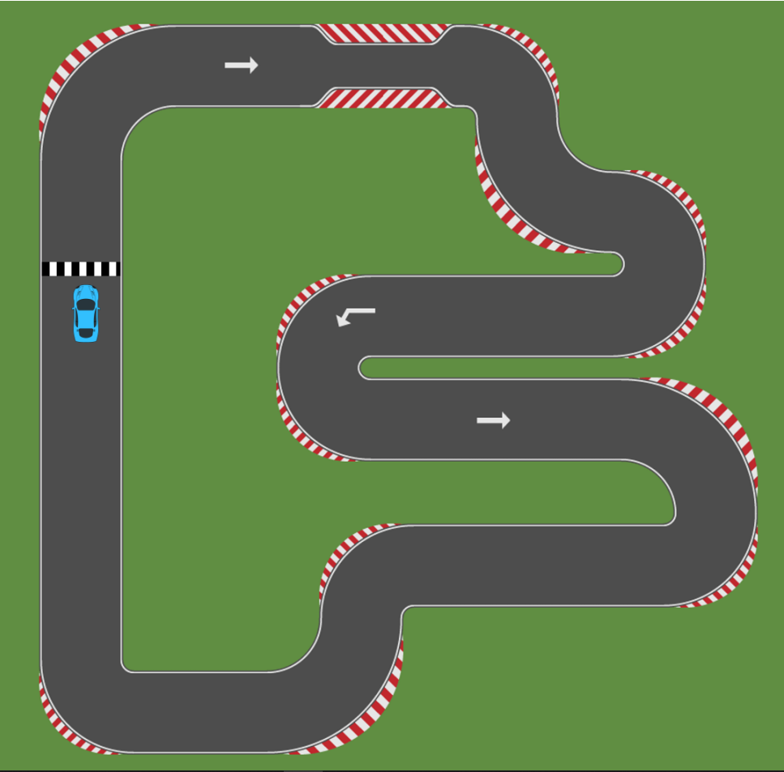
Work Completed
Project Report first draft
SRS first draft
TDD – CRC cards
Very basic C++ starter project
Track
Car movement

Slide 7
Work to do
Complete first draft of TDD
Implement Machine learning algorithms in Python
Finish base game
Export data from Python, save to file and import in into C++
Update Game based on imported data

